Slide 1
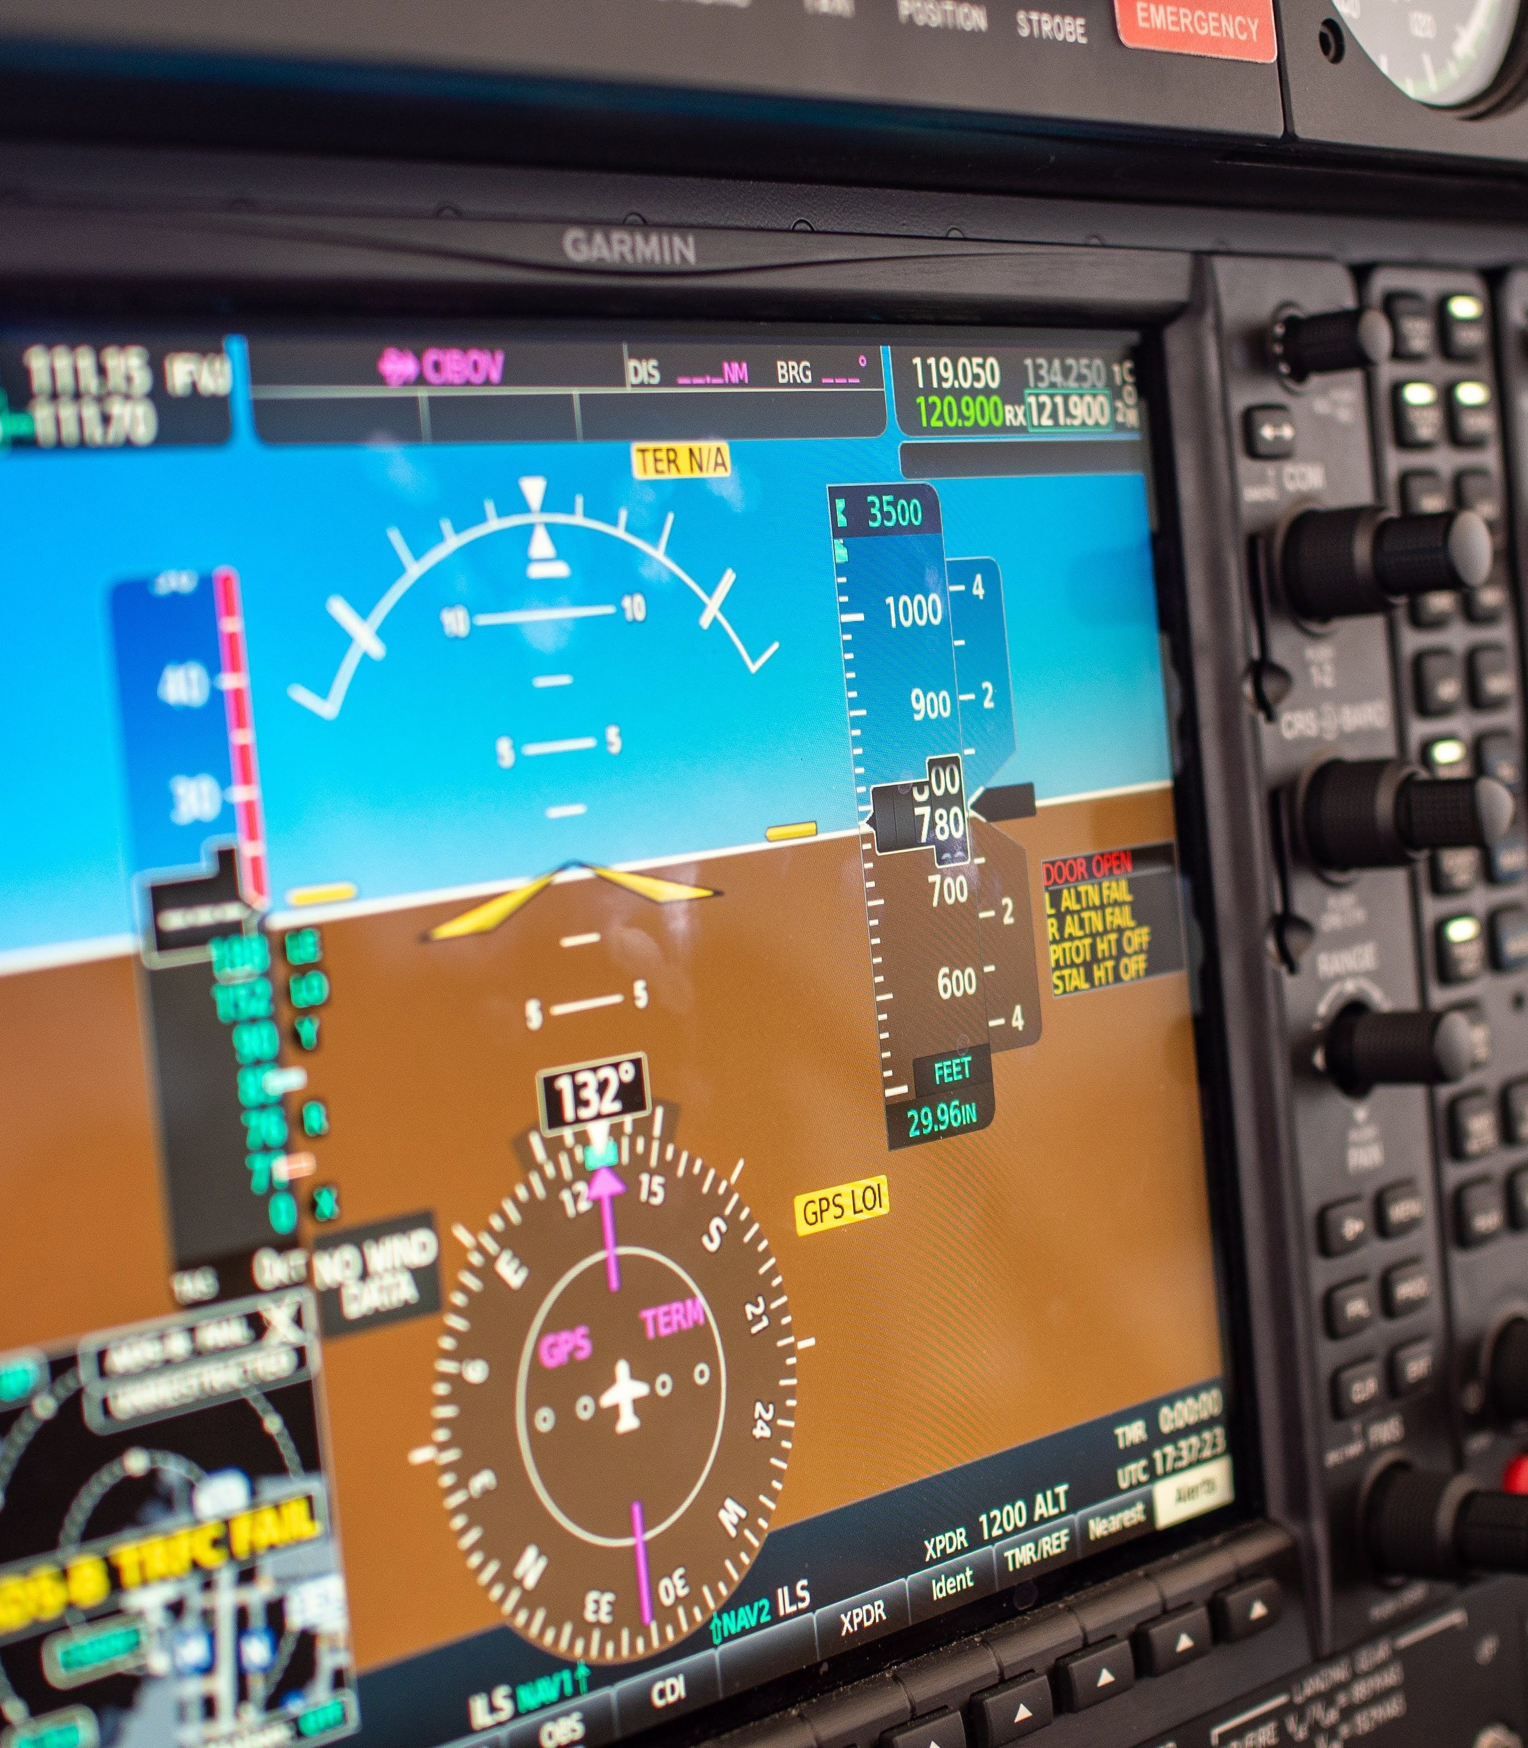
The session that you are trying to view will begin shortly!

Slide 2
The session that you are trying to view is on break and will return shortly!

Slide 3
The session that you are trying to view is no longer being streamed live.
Please visit out virtual platform to see the session information:
https://virtual-dasc.org

Slide 4
Sponsors
Co-Sponsors

Slide 5
Platinum Sponsors

Slide 6
Virtual Sponsors

Slide 7
Media Sponsor

